Slide 1
CIS 1230
Chapter 1
Office Fundamentals
Notes:
When you interact with a personal computer, you’re interacting with the Windows operating system (Windows 7) and various applications (the Microsoft Office Suite).
Microsoft created the Office Suite, which includes Word, Excel, PowerPoint, and Access among other applications─depending on the version that you purchase.
Within these Microsoft applications, there are certain fundamental similarities that create a common user interface.
In this chapter, we will be looking at the basics of these Office Fundamentals and how to work with files and folders.

Slide 2
Objectives
Use Windows Explorer
Work with folders and files
Select, copy, and move multiple files and folders
Identify common interface components
Get Office Help
Notes:
One of the first components you’ll learn about is how to use Windows Explorer.
You’ll also learn how to:
Work with folders and files, including selecting, copying, and moving multiple files and folders.
Identify these common interface components, but how to use them in the different applications.
Access Office’s Help feature.
Objectives are continued on the next slide.

Slide 3
Objectives (continued)
Open and print a file
Close a file and application
Select and edit text
Use the Clipboard group tasks
Use the Editing group tasks
Insert objects
Review a file
Change page settings
Notes:
In addition, you’ll learn how to :
Work with files ─how to open and close files, folders, and applications, print a file, and select and edit text within an application.
Use the Clipboard group tasks.
Insert objects within applications using the Insert tab.
Review a file and change page settings.

Slide 4
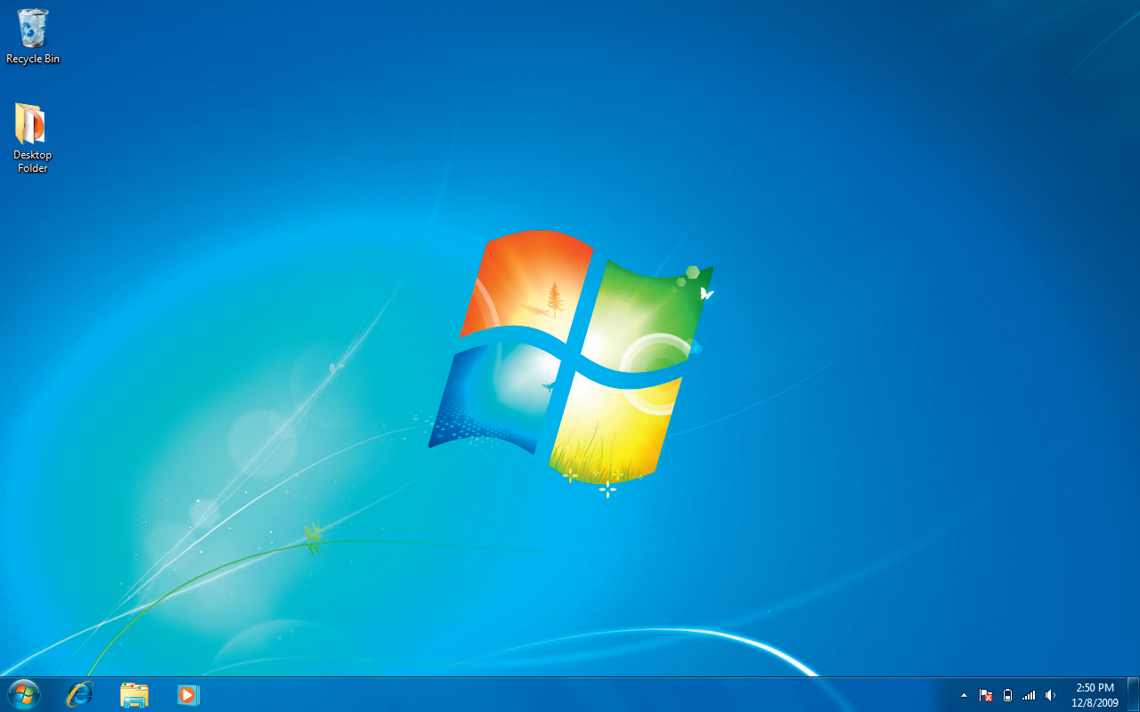
Accessing the Windows Explorer Interface
Windows Explorer on the Taskbar
Right-click on the Start Button and click Open Windows Explorer.
Windows Explorer
Notes:
Windows Explorer is where you manage files and folders and view and access the contents of your storage media.
The purpose of a computer folder is to help you organize your data in labeled storage locations. The storage locations store related files for easy retrieval.
A folder structure can occur across several levels; in other words, you can create folders within folders within folders, etc. These folders within folders are called subfolders and can be arranged according to each folder’s purpose.
Windows 7 introduced the concept of libraries, which are folders that gather files from different locations and display the files as if they were all saved within a single folder, no matter where they are actually stored.
To access the Windows Explorer interface, you can either:
Click the Windows Explorer button on the Taskbar ,or
Right-click the Start Button and click Open Windows Explorer.

Slide 5
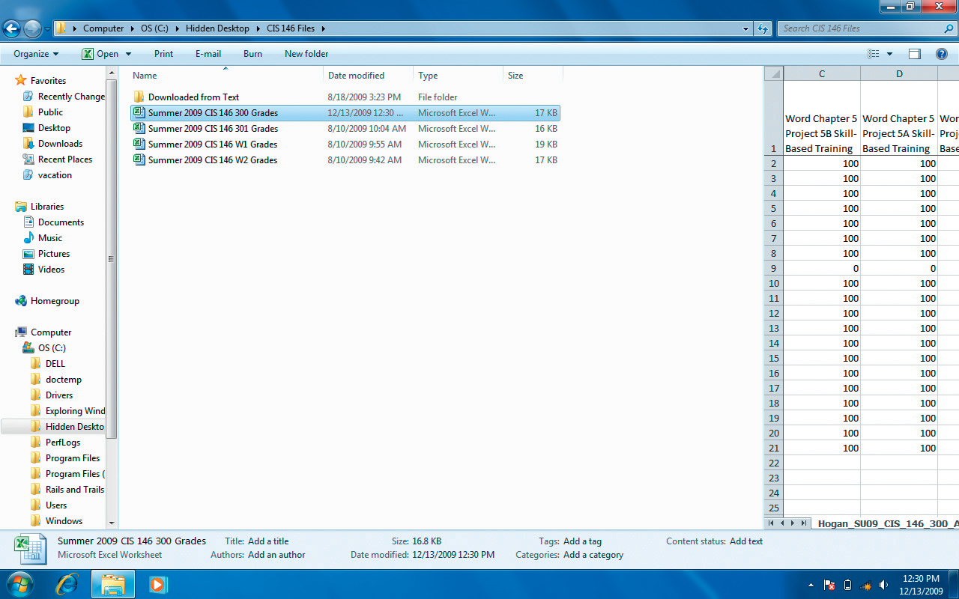
The Windows Explorer Interface
Show or hide the preview pane
Address bar
Toolbar
Help button
Change your view
Search box
Back and forward buttons
Navigation pane
Content pane
Preview pane
Details pane
Notes:
Among the components available from the Windows Explorer Interface is the Navigation Pane.
The Forward and Back buttons provide access to previously opened folders or libraries.
The Toolbar includes buttons that are relevant to the currently selected item. For example, if you were working with a music file, the toolbar buttons might include a button for burning to a CD, whereas if you had a document open, the toolbar would allow you to open or share a file.
The Address bar allows the user how to navigate to other folders or libraries, and the Content pane shows the contents of the currently selected folder or library.
The Search box allows users to find files and folders by typing in descriptive text, and Windows immediately begins searching after you type in the first character, further narrowing results as you type.
The Details pane shows properties associated with a selected file, and the Preview pane provides a snapshot of a selected file’s contents; however, you cannot preview the contents of a folder.

Slide 6
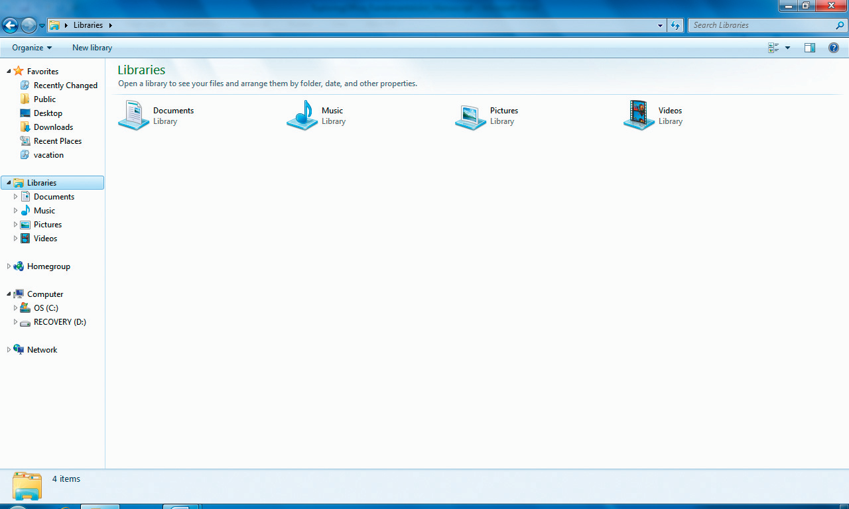
Navigation Pane
Favorites
Libraries
Homegroup
Computer
Network
Notes:
The Navigation Pane contains five areas which provide different methods of organizing your computer’s contents. These components include: Favorites, Libraries, Homegroup, Computer, and Network.
The Favorites area provides access to frequently accessed folders and recent searches.
Libraries provide access to related files by including the files in a common library, no matter where the file actually resides.
Homegroup is a Windows 7 feature that enables users on a home network through a Homegroup to share resources and is password protected for security.
The Computer area provides access to specific storage locations, such as your hard drive, CD/DVD drive, and removable media, such as a flash drive.
The Network area provides easy and quick access to devices connected to devices to your home network, allowing you see the contents of networked computers.

Slide 7
Customizing the Windows Interface
Change the view
Change the size of icons
Change the amount of detail
Show or hide Windows Explorer panes
Notes:
There are several options that you can use to customize your own view of the Windows Explorer interface.
You can modify the view by making the icons small, medium, large, or extra large; or by providing additional detail by clicking on the Change your view arrow and selecting from the views provided.
To show or hide Windows Explorer panes, click Organize on the Toolbar, point to Layout, and then select the pane you want to show or hide. You can also widen or narrow panes by clicking and dragging a border when the mouse changes to a double-headed arrow.

Slide 8
Windows Explorer
Managing libraries
Accessing information on:
Networked drives
Shared disk drives
Using Favorites feature
Notes:
In addition to managing files and folders, Windows Explorer also allows you to manage libraries.
Libraries are collections of related data from various physical locations. Windows 7 includes several libraries that include default folders or devices. A folder can be added to a library by right-clicking on the folder and pointing to Include in library. Then select an existing library or create a new one.
Windows Explorer also provides information on networked resources and shared disk drives.
You can also access frequently used areas by using the Favorites feature of Windows Explorer.

Slide 9
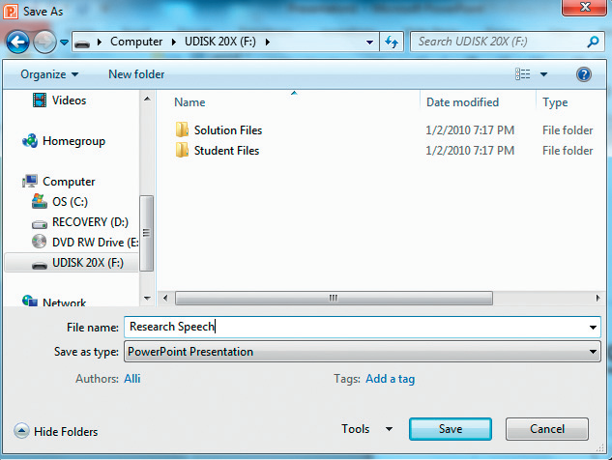
Working with Folders and Files
Create folders
Files
Create
Rename
Delete
Move
Copy
Save
Click here to create
a new folder
Notes:
In Windows Explorer, you can create folders in different ways. You can create a folder structure within Windows Explorer, or you can create a folder from within an application at the time that you need the new folder. Once created, however, files can be renamed, deleted, moved, or copied within Windows Explorer.
A word of caution, though, about deleting files or folders. Although you can recover most files and folders that have been deleted, it is much better to be absolutely sure before you delete a file or a folder. The Recycle Bin only receives files deleted from the hard drive, not from removable storage media. For example, once you’ve deleted a folder from a storage device—it’s gone forever. So, be sure before you delete!
On the other hand, when you create a file, whether it be a document, spreadsheet, or presentation, your file is placed in RAM, which is the computer’s temporary memory. How you save the file is dictated by the application you’re working within. When you save the file, whatever application you’re in, the application will ask you to choose where to save the file (in which folder) and what you want to name the file. Saving the file with a meaningful or descriptive name will be helpful when trying to find the file later.

Slide 10
Selecting, Copying, and Moving Multiple Files and Folders
Back up your data to protect it
Copy all files contained in a folder
Copy all folders in a library
Notes:
In this section, you’ll learn how to select, copy, and move multiple files and folders using Windows Explorer.
One of the most important things you can do to protect your data is to back up (or copy) your files from one location to another; for example, copying your files from your computer’s drive to an external backup storage or an online storage location.
When you copy or move a folder, you also copy all of the files contained within that folder.
You can access multiple files and folders by accessing the library to which they are linked. This is a quick method of accessing all files that are related, such as all of your pictures on your hard drive. If they’ve been placed in a library, you can copy the library to another storage device, copying all of the files no matter where they are on the hard drive.

Slide 11
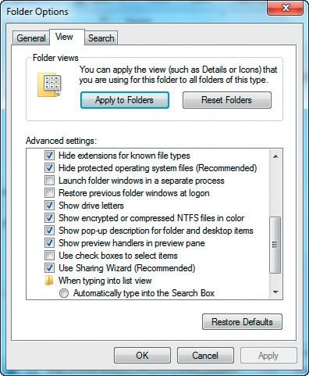
Folder Options Window
Click here to select items
with check boxes
Notes:
To activate the Folder Options dialog box, open Windows Explorer, and then change the view to Details. Click Organize, and then select Folder and search options. The Folder Options dialog box opens. Click the View tab, scroll down in the Advanced settings box, click in the check boxes to select items, and then click OK.
The Hide extensions for known file types is one you might want to deselect. It hides the extensions of known file types and—as of Office 2007—the file extensions have changed. You might be tempted to type in the extension if you do not see it in the Save file dialog box within the Office applications, which would result in duplicate extension names—for example, Myfile.docx.docx.

Slide 12
Working with Multiple Files and Folders
Using the Shift key
Using the Ctrl key
Using the Right-click
Notes:
There are several ways in which to copy, delete or move multiple files or folders, depending on whether the files and/or folders are adjacent or not.
If the files you are selecting are contiguous (adjacent, or next to each other), select the first file, hold the Shift key down, and select the last file in the group you want to select. Then you can move them, copy them, or delete them all at one time.
If the files you are selecting are noncontiguous (non-adjacent, or not next to each other), select the first file, hold the Ctrl key down, and select each file one at a time in the group you want to select. Then you can move them, copy them, or delete them all at one time.
You can also right-click on an individual file or folder and select Cut or Copy and then click in the folder you want to paste the file to and right-click and select Paste.

Slide 13
Microsoft Office Software
Word 2010
Excel 2010
PowerPoint 2010
Access 2010
Notes:
The Microsoft Office Suite is mainly used as a productivity software suite, and includes four primary software components: Word, Excel, PowerPoint ,and Access.
Word is a word processing software used with text to create, edit, and format documents. These documents include everything from letter and memos, to reports, brochures, resumes, and newsletters or flyers.
Excel is used for number-crunching, utilizing spreadsheets to store quantitative data and to perform accurate and rapid calculations. The results range from simple budgets to financial and statistical analyses.
PowerPoint is a presentation graphics software designed to create slide shows for presentations. Presentations can be created by a speaker, published on a Website, or run as a stand-alone application on a computer in a store or mall kiosk.
Access is a relational database software that is used to store data and covert that data into meaningful information. Databases are primarily used by businesses for decision-making by compiling data from multiple records stored in tables to produce informative reports. Access can also be used by the home user to keep track of household inventory, DVDs, music, and picture collections as well as a wide range of other options.

Slide 14
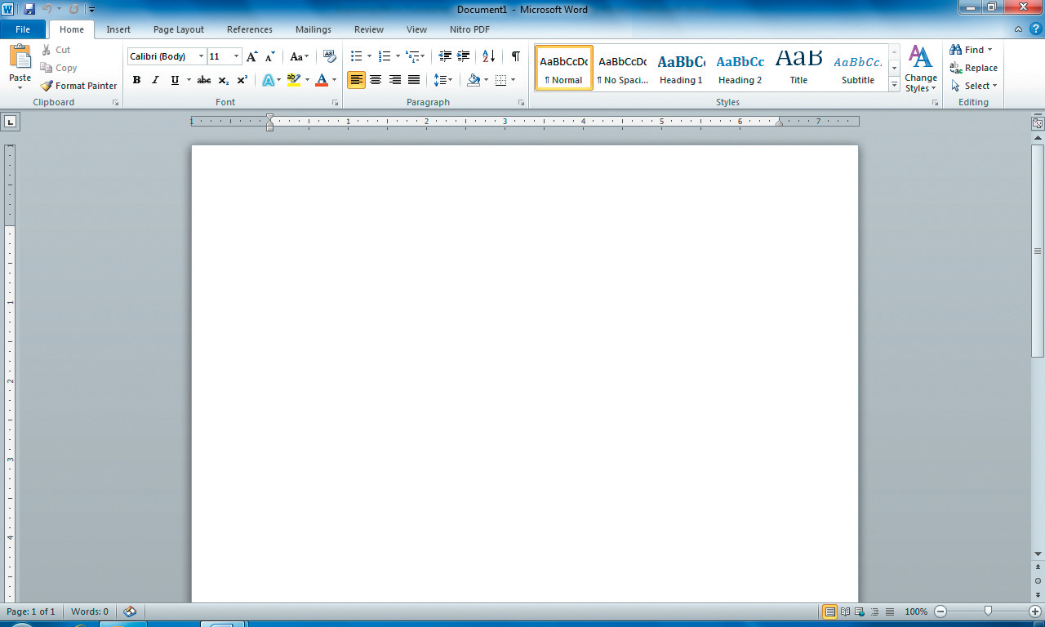
Common Interface Components
Quick Access Toolbar
Minimize button
Maximize/Restore
Down button
File tab
Title bar
Close button
Ribbon
Status Bar
Notes:
Microsoft’s Common User Interface (its screen display) is one of the primary reasons that Microsoft has become so popular among users. By having a common interface among its applications, the learning curve for users is reduced ,making it much easier to begin creating and working within the individual applications.
Among the Common Interface Components are the Title bar, the Quick Access Toolbar, the Ribbon, the Status Bar, and Backstage, a new feature in Office 2010.

Slide 15
Title bar
Identifies the open file’s name
Contains control buttons
Minimize
Maximize/Restore Down
Close
Maximize/Restore
Down button
Minimize button
Close button
Title bar
Notes:
The Title bar identifies the currently open file’s name and contains the control buttons in the upper right corner.
The control buttons include the Minimize, the Maximize/Restore Down, and Close buttons. Minimize does not close the application, but reduces it down and places it on the Taskbar. The Maximize/Restore Down button either maximizes a less than maximized window or restores a window to its previous size. The Close button closes the application.

Slide 16
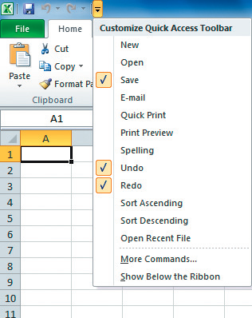
The Quick Access Toolbar
One-click access to commonly used features
Undo, Redo (Repeat), and Save
Can be customized for each application
Customize Quick Access
Toolbar menu
Quick Access Toolbar
Notes:
The Quick Access Toolbar, at the top-left of the Title bar, gives the user access to commonly used features, including the ever popular Undo, the Redo (or Repeat), and the Save buttons.
The Quick Access Toolbar can be customized within each application, providing the user with the option to customize each application’s Quick Access Toolbar to the commonly used features within that application.

Slide 17
Backstage
Enables common activities for files
Open
Close
Save
Print
Provides information on open files
Notes:
Backstage is a new component in Office 2010.
With this component, the user is provided with a concise collection of commands related to an open file, such as printing, saving, opening, closing, and sharing the file.
You can also view the properties and other information related to the file.
A file’s properties include the author, file size, permissions, and date modified.
You access Backstage by clicking the File tab.

Slide 18
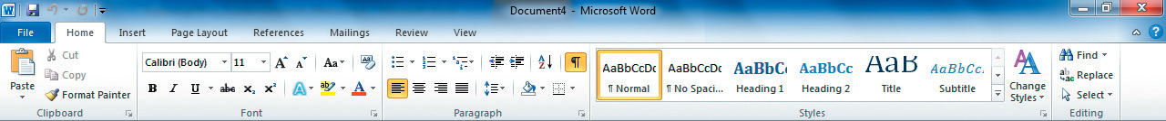
The Ribbon
Beneath the Title bar
Includes
Tabs
Groups
Commands
Tabs
Commands
Groups
Notes:
The Ribbon is found beneath the Title bar and contains tabs, groups, and commands.
Each Tab contains groups of related tasks.
Each Group is a subset of the Tab that organizes similar tasks together.
Each Command is a button or area within a Group that you click to perform tasks.
Because Word, Excel, PowerPoint ,and Access share the common Tab/Ribbon structure, you will quickly and easily learn how to move around within the applications, particularly since many of the applications share the same tabs with many of the same options . Of course, each application will also have some different Tabs, Groups, and Commands specifically related to the operations of that application.

Slide 19
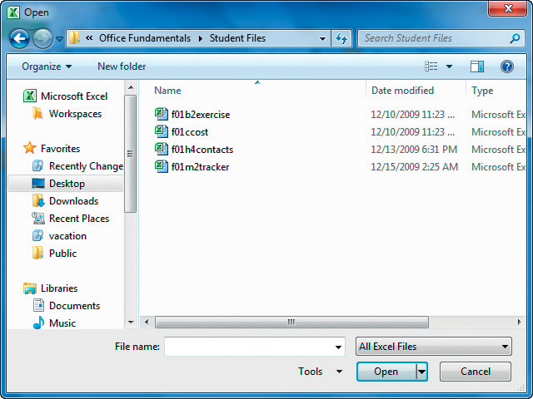
Additional Ribbon Features
Dialog boxes
Dialog Box Launcher
Gallery
Live Preview
Contextual tabs
Notes:
Although the Ribbon will provide quick access to the most common activities , there are less frequently used features, which are still available to the user, but not available on the Ribbon.
A dialog box is a window that enables you to make selections or indicate settings extending beyond those available on the Ribbon.
A Dialog Box Launcher is an icon in Ribbon groups that you can click to open a related dialog box, but it is not available in all groups. For example, Word provides a list of common text styles, but there so many that they cannot easily be viewed on the Ribbon. A gallery provides access to view these additional styles. Also, by moving your mouse over the gallery selections, you can see how your text would appear if you clicked on the selection your mouse is hovering over. This is the Live Preview feature and can save you a great deal of time.
Contextual tabs are made available when you select a particular object ,such as a table or picture. Contextual tabs appear to the right of the standard tabs and disappear when you click away from the object.

Slide 20
Status Bar
Contains information relative to an open file
View buttons Zoom Slider
Notes:
The status bar is found at the bottom of an application’s window and contains information relevant to the open file.
It includes tools for changing the view of a file and for changing onscreen file contents. For each application, the status bar is unique, but there are some similarities, such as the Zoom slider and the View options (although the type of views available will change depending on the application.)
Note: You can also use the View tab on the Ribbon to change the current view or zoom level of an open file.

Slide 21
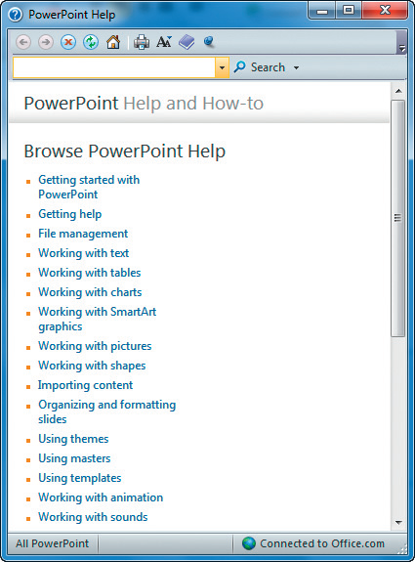
Getting Help from Office
Search box
Help topics
Notes:
One of the more frustrating aspects of learning a new version of software is that you may not know where the Help option is in the new version. Fortunately, Microsoft provides help for the user in its Windows operating system and in each of its Microsoft Office applications.
You can obtain help from Microsoft Office applications by clicking on the Help button—the question mark (?) in the top-right corner of the Ribbon.
You can also click the File tab to open Backstage and then click Help. Assistance is available from within a dialog box by clicking the Help button in the top-right corner of the dialog box.
In addition, if you move your mouse pointer over any command on the Ribbon, you will see an Enhanced ScreenTip providing a brief summary of the command.

Slide 22
Working with Files
Opening a file
Printing from a file
Closing a file and application
Selecting and editing text
Font attributes
Notes:
Working with files in Microsoft Office is easy.
After saving a file, you can open it by clicking the File tab and selecting Open. If you have recently worked with a file, you can reopen it from the Recent Documents list, which is displayed when you click Recent on the Backstage.
No matter which Microsoft application you’re in, you can open a new or an existing file. You can select and edit text from a file, and you can also print from that file. You can also close either the file or the entire application.

Slide 23
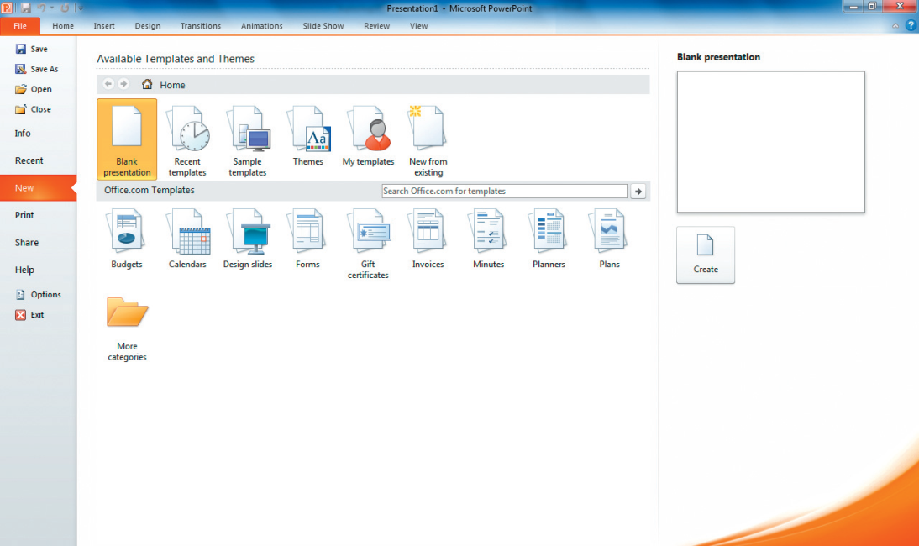
Opening a File
Opening a new file
Opening an existing file
Opening a new file using a predefined template
Templates available in a
typical Office installation
Templates available
from Office.com
Notes:
Opening a new file can be done from the File tab, from Backstage. From the File tab, just click on New, and then double-click on Blank Document (if you’re in Word), Blank Presentation (if you’re in PowerPoint) or Blank Workbook (if you’re in Excel), or you can single-click on the Blank option and then click Create.
Opening an existing file can be done from the Open dialog box, which will give you options on the left side to help you find your file, including the Recent Document list if it is a file on which you were recently working.
In addition, you don’t have to create all files from scratch. All Microsoft Applications have predefined templates that you can access by clicking on the File tab, and then clicking New. A template is a predefined file that you can modify to suit your needs. Templates are divided into categories to help you narrow your search on the particular template you need.

Slide 24
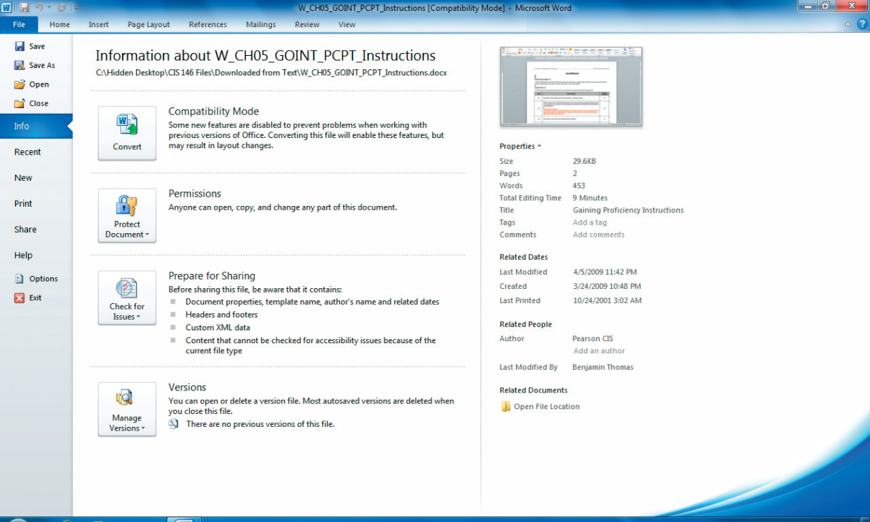
Printing from a File
Print Preview
Printing
Backstage View
Notes:
Although you can print your file at any time, it is highly recommended that you use Print Preview before printing. It’s amazing the amount of paper you can save using this simple process. Your file may look good on the screen, but when you Preview the file, you’ll be amazed at how many little things you may find that you want to fix or change before actually printing the final version. Print Preview is available from the File tab.
When you are ready to print, Microsoft gives you several options, such as how many copies or which specific pages to print. Backstage view will also provide additional information about your document, such as how the document will print, the margins, the document’s orientation, the size of document, and how many pages to print per sheet.

Slide 25
Closing a File or Application
Closing an individual file
Closing an application
Saving as you close
Notes:
Although you can have multiple files (and applications) open at the same time, it is always a good idea to try to limit the number of open files because having too many files open at the same time can become overwhelming.
You can close an individual file by clicking on the File tab, and click on Close.
You can close an application and all of its open files at one time by clicking on the File tab, and click on Exit.
If you are prompted to save any of the files, make sure you click on Save, otherwise you will lose any changes you made to your file.

Slide 26
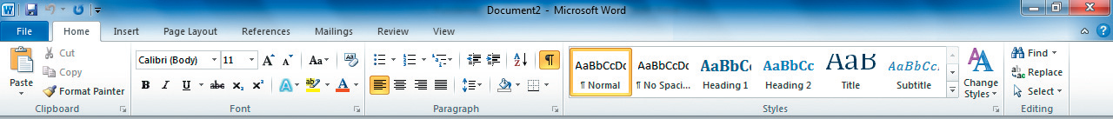
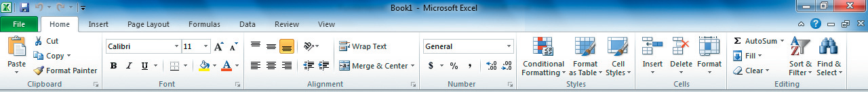
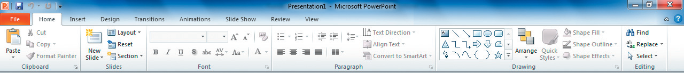
Home Tab Tasks
Word
Excel
PowerPoint
Notes:
Home tab groups and tasks in the various applications have similarities and differences. You will find that you will repeat some tasks often, whether in Word, Excel, or PowerPoint.
You will frequently want to change the format of numbers or words, selecting a different font or changing font size or color. You might also need to change the alignment of text or worksheet cells. Undoubtedly, you will find a reason to copy or cut items and paste them elsewhere in the document, presentation, or worksheet. And you might want to modify file contents by finding and replacing text. All of those tasks, and more, are found on the Home tab of the Ribbon in Word, Excel, and PowerPoint. The Access interface is unique, sharing little with other Office applications, so this section will not address Access.

Slide 27
Selecting and Editing Text
Selecting text to edit
Select then do
Shortcuts to selecting text
Editing text
Mini toolbar
Notes:
After creating a document, worksheet, or presentation, there will most likely be changes you will want to make to your file. Selecting the text you want to change is the first step and there is an easy rule that goes along with this process: “Select then do.”
The most obvious method of selecting text is clicking and dragging across the text, but there are shortcuts available. Some of these include:
to select a word in a Word document, double-click on the word. This will select the word and the following space, but not any punctuation that might follow the word.
to select a line of text, single-click in the left margin next to the line you want to select.
to select a paragraph, double-click anywhere to the left of the paragraph or triple-click anywhere inside the paragraph.
to select the entire document, use the Ctrl+A key combination or triple-click anywhere in the left margin.
Note: The text gives you more shortcuts for selecting text.
The Mini toolbar automatically appears after you have selected text. This toolbar provides many of the most commonly used commands for the type of selection you’ve made, depending on the application you’re in. Unlike the Quick Access toolbar, though, the Mini Toolbar is not customizable. To permanently disable the Mini toolbar, click on the File tab, and click Options. Under General, deselect the Show Mini Toolbar and then click on OK.

Slide 28
Font Attributes
A character design (how the font will appear)
Each Office application has its own default font
Fonts can be changed
Toggle commands
Notes:
A font is a character design that includes size, spacing, and shape. Each Office application has a default font, but you can always change the font.
Other font attributes are boldfacing, italicizing, and font color. Some commands, such as Bold and Italic, are called toggle commands, because when you click on the command, such as Bold, it selects the command, and when you click again on the command, it deselects it.

Slide 29
Clipboard Tasks
Cut
Copy
Paste
Shortcut menu
Format Painter
Notes:
The Clipboard is an Office feature that temporarily holds selections that have been cut or copied. Paste does not affect the Clipboard. Rather, Paste allows you to paste your selection one or more times in different locations.
When you cut or copy multiple items within Office applications, you can view the contents of the Clipboard task pane by clicking on the Clipboard down arrow on the Home tab in the Clipboard group. This pane allows you to select which item you want to paste. You can also clear the Clipboard by clicking Clear All.
When you cut a selection, you remove it from its original location and place it on the Office Clipboard.
When you copy a selection, you place a copy of the selection on the Office Clipboard, without removing it from its original location.
When you paste a selection, you can place the cut or copied selection once or many times in different locations.
You can cut, copy, and paste from the shortcut menu, which appears when you right-click a the selection.
The Format Painter, unlike the copy command, copies only the formatting of the text from one location to another. This feature is extremely useful when you want to copy the formatting of a selection, such as a paragraph, to other paragraphs, without copying the text as well.

Slide 30
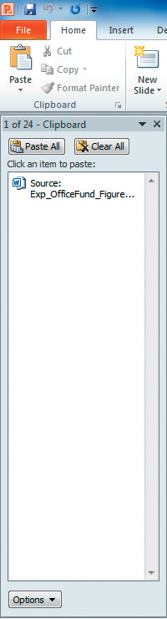
The Clipboard
Clipboard Dialog
Box Launcher
Clipboard task pane
Notes:
The Clipboard is an Office feature that temporarily holds selections that have been cut or copied (paste does not affect the Clipboard). Paste allows you to paste your selection one or more times in different locations.
When you cut or copy multiple items within Office applications, you can view the contents of the Clipboard task pane by clicking on the Clipboard down arrow on the Home tab in the Clipboard group. This pane allows you to select which item you want to paste. You can also clear the Clipboard by clicking Clear All.

Slide 31
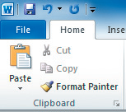
Clipboard Tasks
Cut
Copy
Paste
Format Painter
Shortcut menu
Cut
Paste
Copy
Format Painter
Notes:
When you cut a selection, you remove it from its original location and place it on the Office Clipboard.
When you copy a selection, you place a copy of the selection on the Office Clipboard, without removing it from its original location.
When you paste a selection, you can place the cut or copied selection once or many times in different locations.
The Format Painter, unlike the copy command, copies only the formatting of the text from one location to another. This feature is extremely useful when you want to copy the formatting of a selection, such as a paragraph, to other paragraphs, without copying the text as well.
You can cut, copy, and paste from the shortcut menu, which appears when you right-click a the selection.

Slide 32
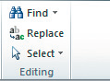
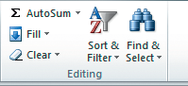
Editing Group Tasks
Word and PowerPoint
Editing group
Excel Editing group
Notes:
The Editing Group contains tasks that include the Find button, Replace button, and Select buttons.
At times, you will find it necessary to locate certain words; for instance, you may want to replace a maiden name with a married name. You can do this with the Find and Replace buttons. The Find button will locate the characters you place in the text box. You then type the replacement text in the Replace textbox. You have the option to check each word by clicking on Find Next and Replace or to select Replace All, which will replace all of the occurrences without you having to check each one.
Caution: when using the Replace All button, make sure you’ve typed in exactly what you want to replace, otherwise you may find yourself repeating the process to fix things you didn’t intend to replace. Be as specific as possible. As an example, avoid typing in something like “the” to replace it with “an” because ,unless you specify whole words only, you’ll replace every occurrence of “the” with “an”. This would include instances where “the” is a part of a word, such as “there.” In that case, the resulting word would be “anre.” Then you would have to Undo and begin again.
The Select command allows you to select objects, such as pictures, to move them, copy them, or delete them.

Slide 33
Inserting Objects using the Insert Tab
Insert or add items into a file
Some commands are specific to each application, such as charts and tables in Excel
Others are common across applications, such as Illustrations
Notes:
The Insert tab allows the user to insert, or add, items into a file. Each application has its own set of commands for insertion. Word , for instance, is generally text related, whereas Excel’s Insert tab is focused on inserting items, such as charts and tables.
In spite of differences among the applications, they share the Illustrations group, which allows the user to insert pictures, clip art, shapes, SmartArt, and other objects.

Slide 34
Inserting Objects
Pictures
Clip art
Shapes
Screenshots
SmartArt
Notes:
All of these items are considered objects and, as such, can be inserted into your files using the Insert tab.
When an object is selected, handles surround the object making the object active. These handles allow you to change or modify the object. To deselect the object, simply click anywhere else in the file away from the selected object.
Pictures, graphic files, are retrieved from storage media and placed in an Office project.
Clip art is an electronic illustration that can be inserted into an Office project. Microsoft Office has a huge library of clip art included with each Office installation, but you can also access clip art from the Web as well.
Shapes, Screenshots and SmartArt are other objects that can be inserted into a file and can be changed or modified by the user.

Slide 35
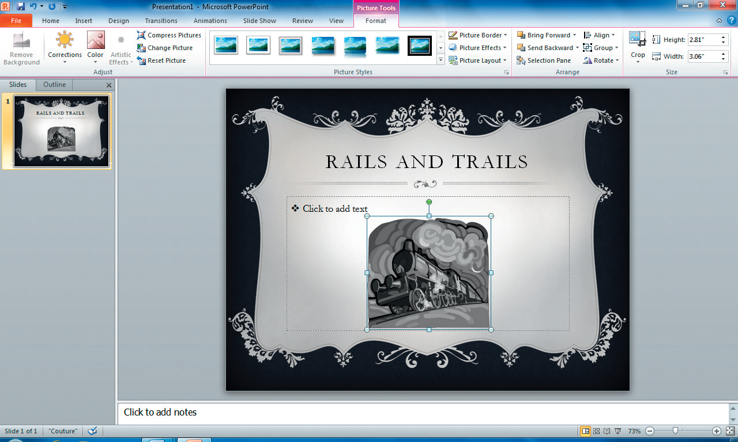
Pictures
Notes:
After an object has been inserted, you can click the object to select it or click anywhere outside the object to deselect it. When an object is selected, a border of small dots, or “handles,” surrounds it, appearing at each corner and in the middle of each side.
Unless an object is selected, you cannot change or modify it. Once an object is selected, the Ribbon expands to include one or more contextual tabs that relate to the object and allow you to modify and manage it.

Slide 36
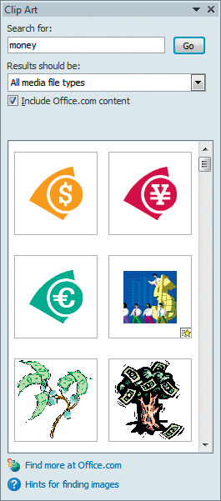
Clip art
Notes:
A large library of clip art is included with each Office installation. Office.com, an online resource providing additional clip art and Office support, is also available from within each Office application.
To explore available clip art, click the Insert tab within an Office program, and then click Clip Art in the Illustrations group (or the Images group in PowerPoint).
Once you have opened the Clip Art task pane, you can click in the Search for box and type in a search term, such as money. To limit the results to a particular media type, click the arrow beside the Results should be box, and make a selection. Then, click Go to initiate the search. Once entered the clip art into your file, you can resize and move it just as you would a picture.

Slide 37
Reviewing Files
Spelling
Grammar
Word usage
Thesaurus
Notes:
When you finish editing a file or while you’re editing the file, you should check to see if spelling or grammatical errors exist.

Slide 38
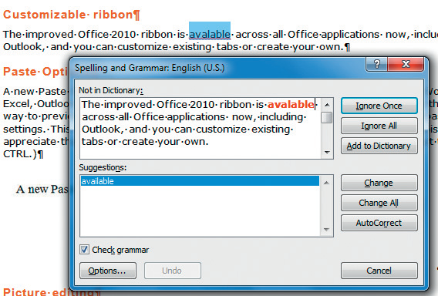
Proofing Commands
Spelling & Grammar Checker
Thesaurus
Notes:
The Spelling feature will find words that it does not recognize, not necessarily indicating that the word is misspelled.
The Grammar checker will help find grammatical and stylistic errors in your text. You can also customize the options you want the Grammar and Style check to search for by clicking on the Options button at the bottom of the Spelling window.
Caution: The Spelling and Grammar features will not find everything that is incorrect with your file. Do not depend solely on Microsoft’s Spelling and Grammar checker to find all errors, particularly with respect to word usage. You are the final authority when it comes to proofreading.
The Thesaurus will help you find synonyms and antonyms to words. You may be overusing a particular word and want to find another word that is still suitable, but different. The Thesaurus can help you look for similar words, but when in doubt, make sure you look up the word you want to replace your original word with to make sure the meanings are the same. Don’t just go for the polysyllabic word to impress your reader (or teacher); make sure you know what the word means!

Slide 39
Changing Page Settings
Page Layout Tab Tasks
Page Setup
─Provides commonly used page options
Page Setup Dialog Box Launcher
─Options unique to each application
Notes:
In Word and Excel, the Page Layout Tab provides access to a full range of options.
For example, in Microsoft Word, you can change margin settings, page orientation, column format, insert breaks, and include hyphenation all from the Page Setup group.
In Excel, you can also change margins and page orientation, but you can also change the size of your printout, change the print area, include page breaks, apply a background, and include repeating print titles.
While the Page Setup group provides the most commonly used page options, options that are unique to each application can be found under the Page Setup Dialog Box Launcher. For example, in Microsoft Excel, you can insert Headers and Footers, print gridlines, and center horizontally and vertically. While some of these options are also available in Word, some are not, so each Page Setup Dialog Box Launcher is unique to its application.

Slide 40
Summary
In this chapter, Office Fundamentals presents the common user interface found in the Microsoft Office suite applications.
Windows Explorer shows users how to copy, rename, and delete files and folders and how to use libraries.
Users are also shown how to create, edit, and insert objects into their files.
Notes:
In this chapter, the user is introduced to Office Fundamentals, primarily the common user interface, which makes moving between applications easy. The common user interface introduced the Title bar, Tabs, the Ribbon, Groups, Commands, and the Status bar and how to use them in the different applications.
Windows Explorer is also presented showing users how to copy, rename, and delete files and folders. Users are also shown how to collect related files and folders into libraries, making accessing related files and folders much easier than just depending on how they are stored or where they are stored.
Users are also introduced to the basics of creating and editing files and how to insert objects into their files using the concepts covered in the common user interface.

